Slide 1


Communities of Excellence 2026 Using a Baldrige-Based Framework to Lead Transformation
A Systematic Approach to Excellence in Communities
In partnership with the Baldrige Performance Excellence Program | 2020
Notes:
Communities of Excellence 2026: A Systematic Approach to Excellence in Communities. Using a Baldrige-Based Framework to Lead Transformation. In partnership with the Baldrige Performance Excellence Program 2020.

Slide 2
Mission
Improve the quality of life for our nation’s residents by assisting communities in implementing the Baldrige-based Communities of Excellence Framework.
Founded in 2010, incorporated as a nonprofit in 2013
Provides a Baldrige-based roadmap to sustainable community excellence
Aligns with the Baldrige mission to improve U.S. competitiveness and performance
Notes:
The mission of Communities of Excellence 2026 (COE) is to improve the quality of life for our nation’s residents by assisting communities in implementing the Baldrige-based Communities of Excellence Framework.
The organization was Founded in 2010 and incorporated as a nonprofit in 2013.
It provides a Baldrige-based roadmap to sustainable community excellence.
COE’s mission aligns with the Baldrige mission to improve U.S. competitiveness and performance.

Slide 3
Collaboration with the Baldrige Program
Adapted the Baldrige Framework to develop the Communities of Excellence Framework
Educate individuals and organizations on the framework
Encourage community assessments against the framework
Share best practices identified through assessments
Notes:
In collaboration with the Baldrige Program, COE
Adapted the Baldrige Framework to develop the Communities of Excellence Framework
Educates individuals and organizations on the framework
Encourages community assessments against the framework
Shares best practices identified through assessments

Slide 4
Communities of Excellence 2026
Hypothesis
That a systems framework proven to drive performance excellence in companies and organizations—the Baldrige Excellence Framework—can be modified to achieve performance excellence in communities to benefit the health and well-being of all residents.
Primary focus areas:
Education
Health
Economic Vitality
Safety
Notes:
The hypothesis of COE is that a systems framework proven to drive performance excellence in companies and organizations—the Baldrige Excellence Framework—can be modified to achieve performance excellence in communities to benefit the health and well-being of all residents.
The primary focus areas are education, health, economic vitality, and safety.

Slide 5
Why a Community Focus on Excellence?
Key indicators of society’s overall health and well-being are declining.
U.S. teenagers rank 36th in math, reading, and science among developed nations.
45 million Americans are living in poverty.
Americans die sooner and experience more illness than residents in many other coun­tries, according to a 2013 Institute of Medicine report.
In rural areas, young people are migrating to cities, and population is declining.
“We should be building stronger communities, not just stronger programs.”—Paul Schmitz, author of Everyone Leads: Building Leadership from the Community Up
Notes:
Why a Community Focus on Excellence?
Key indicators of society’s overall health and well-being are declining.
U.S. teenagers rank 36th in math, reading, and science among developed nations.
45 million Americans are living in poverty.
Americans die sooner and experience more illness than residents in many other coun­tries, according to a 2013 Institute of Medicine report.
In rural areas, young people are migrating to cities, and population is declining.
“We should be building stronger communities, not just stronger programs.”—Paul Schmitz, author of Everyone Leads: Building Leadership from the Community Up

Slide 6
Definition of Community
A community is a set of systems that function together to achieve optimal performance.
Community
Education
Law enforcement
Healthcare
Businesses
Local gov’t
Non-profits/Faith-based Organizations
Notes:
A community is a set of systems that function together to achieve optimal performance.
These systems include education, law enforcement, health care, businesses, local government, and nonprofits/faith-based organizations.

Slide 7
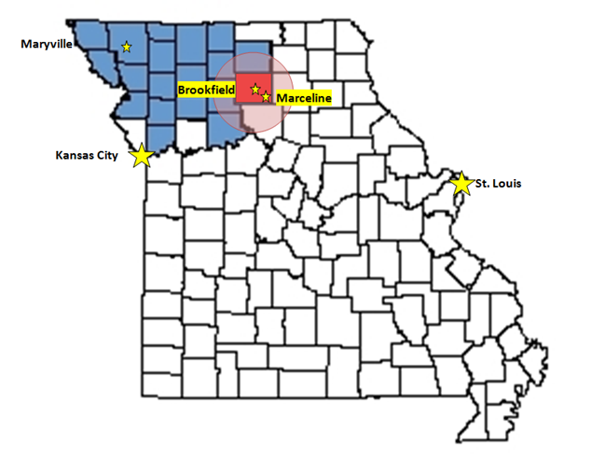
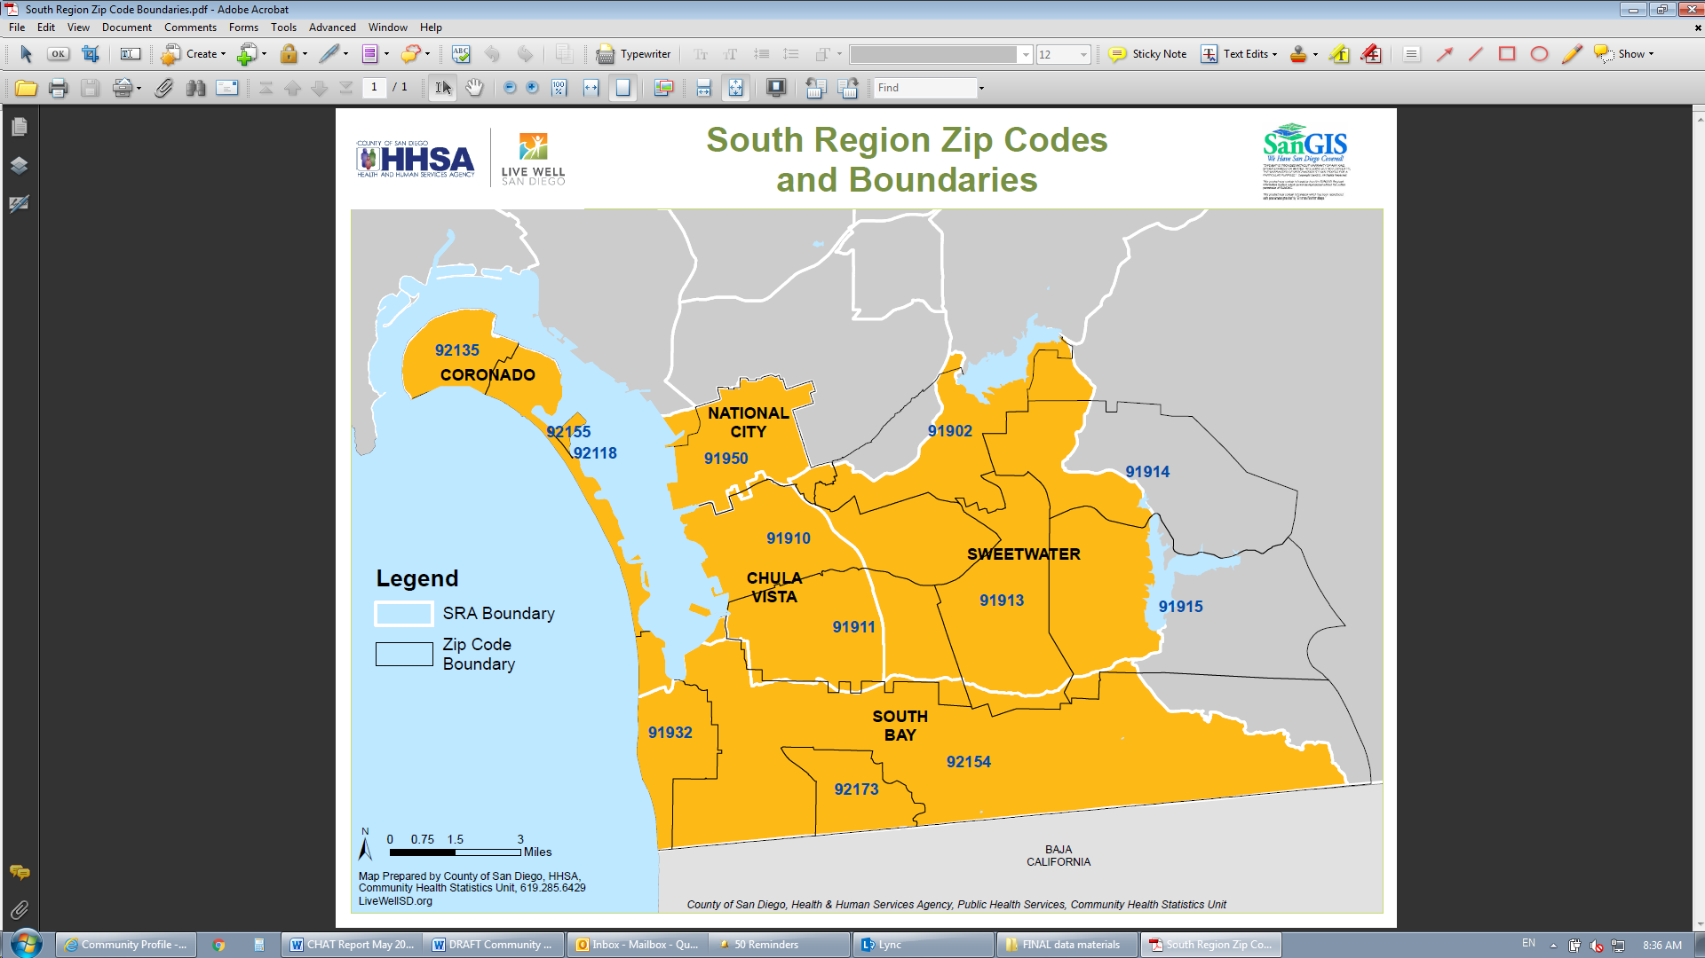
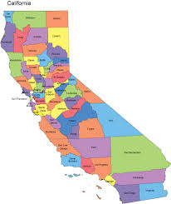
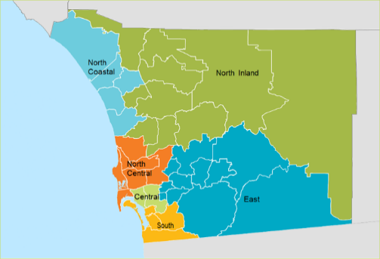
How Does COE 2026 Define “Community”?
A group of people living in the same place or having a particular characteristic in common
“Think Regionally, Act Locally”
Example: Towns of Brookfield and Marceline, Missouri, within the Regional Trade Areas of northwest Missouri
Example: San Diego County’s South Region, California
Notes:
How Does COE 2026 Define “Community”?
A group of people living in the same place or having a particular characteristic in common
Two examples are San Diego County’s South Region, California, and the towns of Brookfield and Marceline, Missouri, within the Regional Trade Areas of northwest Missouri.

Slide 8
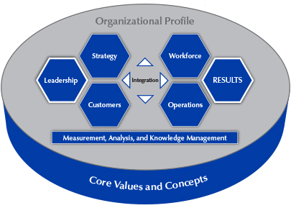
Baldrige Criteria for Performance Excellence
Baldrige Criteria for Performance Excellence
Applicable to any organizational entity
Scalable
Benchmarks excellence
Helps evaluate performance and assess where improvements are needed
Facilitates evidence-based decision making
Notes:
The Community Performance Excellence Framework is based on the Baldrige Excellence Framework. The Baldrige framework is
Applicable to any organizational entity
Scalable
Benchmarks excellence
Helps evaluate performance and assess where improvements are needed
Facilitates evidence-based decision making

Slide 9
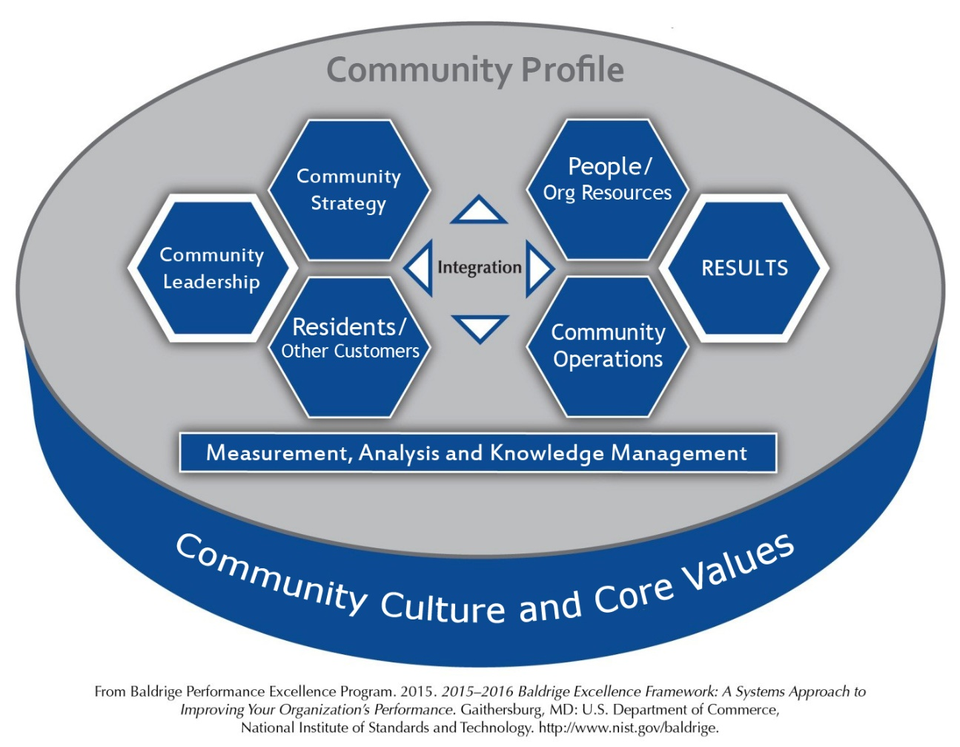
Community Excellence Framework
Is applicable to any community
Unites around common language, shared values, and community understanding
Aligns resources, people, and plans
Leverages community assets, offerings, competencies, and advantages
Infuses quality principles and process improvement
Encourages resident voice
Adapted From:
Notes:
Similarly, the Community Excellence Framework
Is applicable to any community
Unites around common language, shared values, and community understanding
Aligns resources, people, and plans
Leverages community assets, offerings, competencies, and advantages
Infuses quality principles and process improvement
Encourages resident voice

Slide 10
How integrated is the “work” of the community?
How integrated is the “work” of the community?
Community Operations are characterized by activities rather than by processes, largely responsive to immediate needs or problems. Goals are poorly defined.
The community is beginning to carry out shared operations with repeatable processes, evaluation, and improvement, and there is some early coordination among parts of the community. Strategy and quantitative goals are being defined.
Community operations are characterized by repeatable processes that are regularly evaluated for change and improvement in collaboration with other affected parts of the community. The community seeks and achieves efficiencies through analysis, innovation, and the sharing of information and knowledge. Processes and measures track progress on key strategic and operational goals.
Community operations are characterized by repeatable processes that are regularly evaluated for improvement. Learnings are shared, and there is coordination among parts of the community. Processes address key strategies and goals.
Notes:
The Community Excellence Framework helps increase integration in the work of the community.
At the least integrated level, community Operations are characterized by activities rather than by processes, largely responsive to immediate needs or problems. Goals are poorly defined.
At the next level, The community is beginning to carry out shared operations with repeatable processes, evaluation, and improvement, and there is some early coordination among parts of the community. Strategy and quantitative goals are being defined.
At the next level, community operations are characterized by repeatable processes that are regularly evaluated for change and improvement in collaboration with other affected parts of the community. The community seeks and achieves efficiencies through analysis, innovation, and the sharing of information and knowledge. Processes and measures track progress on key strategic and operational goals.
At the most integrated level, Community operations are characterized by repeatable processes that are regularly evaluated for improvement. Learnings are shared, and there is coordination among parts of the community. Processes address key strategies and goals.

Slide 11
To begin
Community Profile
Vision
Strategy
What is your community, and what is important to it? Community Profile
Where do you want to go? Vision
How will your community prepare for the future? Community Strategic Planning
What are the gaps and how do you as a community engage to prioritize which ones to focus on first, next?
How will you know when you get there? Results
Notes:
To begin, the Community Excellence Framework asks communities the following questions:
What is your community, and what is important to it? These answers are reflected in the Community Profile.
Where do you want to go? This is reflected in the community’s vision.
How will your community prepare for the future? This is articulated in a community strategy.
How will you know when you get there? This is reflected in the results tracked by a community.

Slide 12
Step 1: Community Profile
Is a basis for fostering shared understanding
Gives insight into key internal and external factors
Helps you understand
your context
key requirements for success
needs, opportunities, and constraints
Notes:
The Community Profile
Is a basis for fostering shared understanding
Gives insight into key internal and external factors
Helps you understand
your context
key requirements for success
needs, opportunities, and constraints

Slide 13
The Communities of Excellence Learning Collaborative
The Communities of Excellence Learning Collaborative
Year-long learning experience for U.S. communities; live webinars and online communication platform
Establish a diverse, values-driven leadership team composed of residents from your community’s key sectors, generations, and social and economic groups
Develop a Baldrige-based Community Profile and use it to identify the next steps in your community’s excellence journey
Identify desired community outcomes and develop a Community Strategic Plan focused on these outcomes
Notes:
The Communities of Excellence Learning Collaborative is a year-long learning experience for U.S. communities. Communities meet via live webinars and an online communication platform. Through the collaborative, communities
Establish a diverse, values-driven leadership team composed of residents from your community’s key sectors, generations, and social and economic groups
Develop a Baldrige-based Community Profile and use it to identify the next steps in your community’s excellence journey
Identify desired community outcomes and develop a Community Strategic Plan focused on these outcomes

Slide 14
Benefits of the Learning Collaborative
Benefits of the Learning Collaborative
Use the Community Profile as a tool for learning how to work together as a community
Adopt a common language for discussing community issues
Gain focus and direction for your community’s improvement efforts
Shift thinking from activities to outcomes, and from silos to systems
Share ideas and approaches with other participating communities
Build leadership capability and capacity
Notes:
Here are some of the benefits of the Learning Collaborative:
Communities use the Community Profile as a tool for learning how to work together as a community.
They adopt a common language for discussing community issues.
They gain focus and direction for their community’s improvement efforts.
They shift thinking from activities to outcomes, and from silos to systems.
They share ideas and approaches with other participating communities.
They build leadership capability and capacity.

Slide 15
Typical Curriculum and Calendar
October: Introductory workshop (in person)
November–December: Community Profile Focus (online)
January–March: Strategic Planning and Leadership (online)
April–May: Results and Measurement (online)
June: Midpoint Review and Progress Check (online)
July: Residents, Other Customers, People and Organizational Resources, Operations (online)
August: Leadership (online)
September: Presentation of Strategic Plans (online)
Notes:
Here is a typical curriculum and calendar.
October: Introductory workshop (in person)
November–December: Community Profile Focus (online)
January–March: Strategic Planning and Leadership (online)
April–May: Results and Measurement (online)
June: Midpoint Review and Progress Check (online)
July: Residents, Other Customers, People and Organizational Resources, Operations (online)
August: Leadership (online)
September: Presentation of Strategic Plans (online)

Slide 16
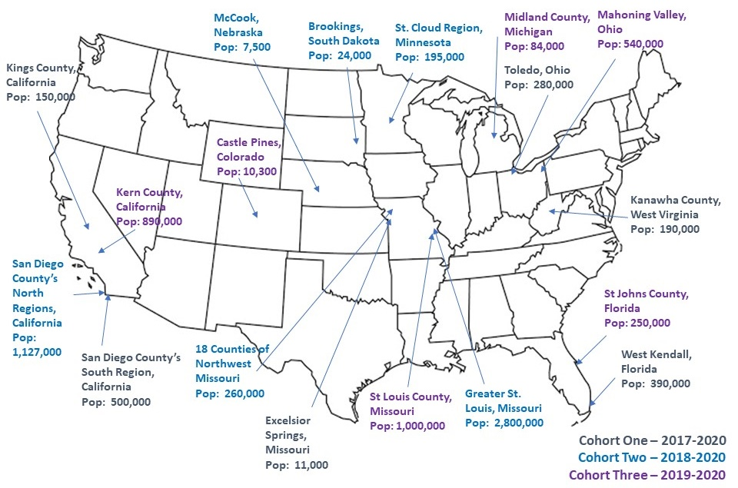
Learning Collaborative Participants
Notes:
The map shows the 18 communities involved in the Learning Collaborative in 2020.

Slide 17
Community Excellence Recognition: Three Levels
Commitment to Community Excellence: Submit responses to the Community Profile
Journey to Community Excellence: Submit responses to the Community Profile, Community Leadership, and Community Strategy; key results
Community of Excellence: Submit responses to all Communities of Excellence Framework categories (the Community Profile and categories 1–7)
Notes:
The Communities of Excellence Recognition program has three levels:
Commitment to Community Excellence: Submit responses to the Community Profile
Journey to Community Excellence: Submit responses to the Community Profile, Community Leadership, and Community Strategy; key results
Community of Excellence: Submit responses to all Communities of Excellence Framework categories (the Community Profile and categories 1–7)

Slide 18
For More Information
Communities of Excellence 2026
Learning Collaborative
Communities of Excellence Framework
Communities of Excellence Recognition Program
http://www.communitiesofexcellence2026.org
snorling@communitiesofexcellence2026.org
Notes:
For more information, go to http://www.communitiesofexcellence2026.org or email snorling@communitiesofexcellence2026.org.

